Slide 1
Emotion Classification using DEAP Dataset ???

Slide 2
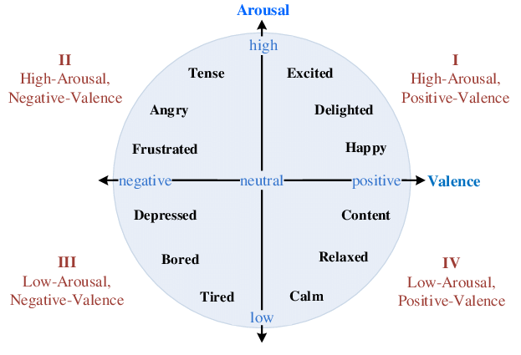
About the DEAP Dataset
A database for Emotion Analysis using Physiological Signals.
Main Goal of dataset to create an adaptive music video recommendation system. Uses Valence-Arousal Scale by Russell for emotion categorisation

Slide 3
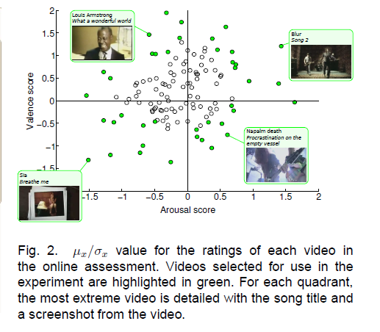

Slide 4
Valence, Arousal, Dominance
Arousal is inactive (uninterested, bored) to active (alert , excited)
Valence is unpleased (sad, stressed) to pleasant ( Happy, elated)
Dominance is from helpless and weak to an empower feeling.

Slide 5
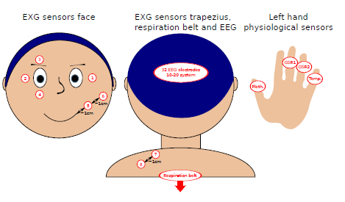
About the dataset
32 participants. 32 EEG electrodes (10-20 system) sampled originally at 512 Hz and 8 peripheral physiological signals recorded.
40 videos(stimuli) of 1 minute each shown to each participant with a break after 20 mins.
Videos were music videos selected on basis of LALV/LAHV/HALV/HAHV and other many criterias of excitement.
Placement of peripheral physiological sensors.
For Electrodes were used to record EOG and 4 for EMG
(zygomaticus major and trapezius muscles). In addition,
GSR, blood volume pressure (BVP), temperature and
respiration were measured.

Slide 6
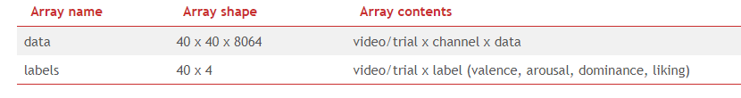
About the dataset (preprocesssed)
The data was downsampled to 128Hz.
EOG artefacts were removed as in [1].
A bandpass frequency filter from 4.0-45.0Hz was applied.
The data was averaged to the common reference.
The EEG channels were reordered so that they all follow the Geneva order as above.
The data was segmented into 60 second trials and a 3 second pre-trial baseline removed. 63 x 128 = 8064
The trials were reordered from presentation order to video (Experiment_id) order.

Slide 7
Questions
Single Trial Classification?
Modality?
MCA Features?

